Slide 1
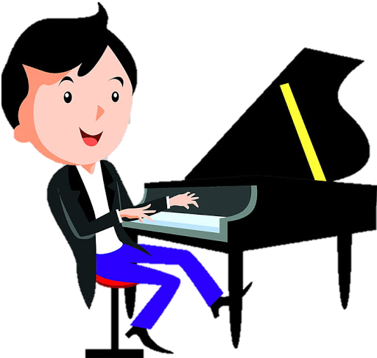














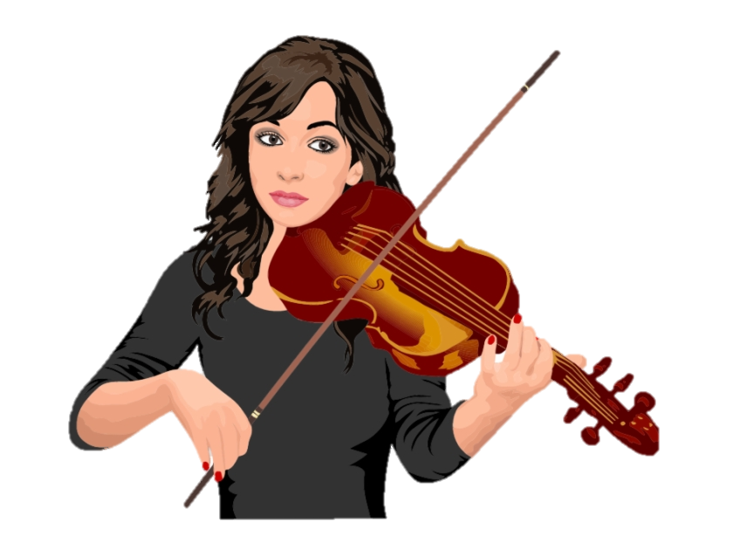


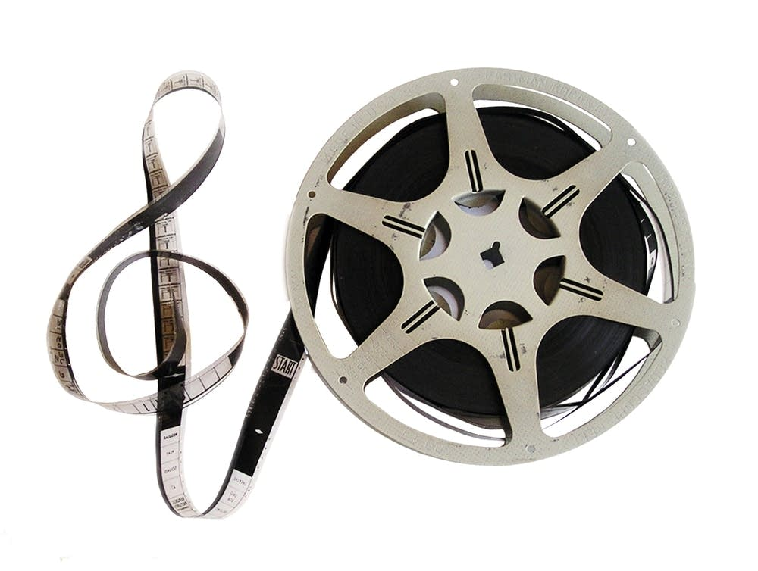

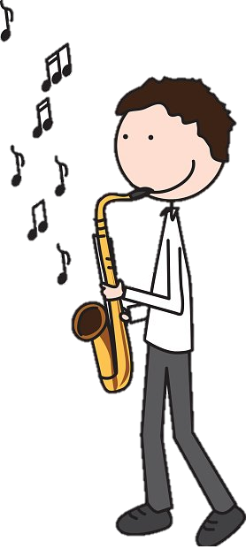


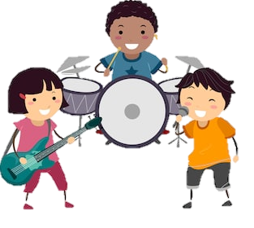
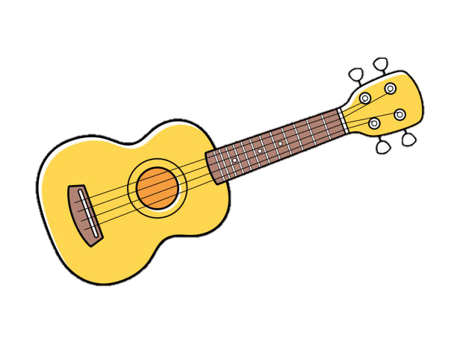



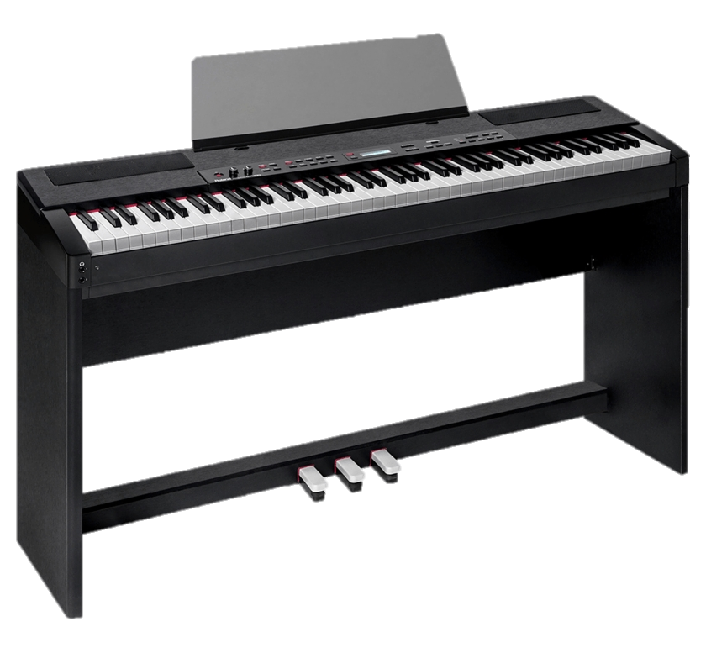











Our Music
Learning Journey
On to college or 6th form
Solo & Ensemble Performance Recordings
One solo and one ensemble performance will be completed and recorded for coursework
Appraising Music
Throughout year 11 we continue with theory and set works ready for your exam at the end of the course
Create Performances using music technology
11
Set Brief Composition
Using the briefs set by the exam-board to create composition 2
Free Brief Composition
Learning about and completing your first GCSE composition (composing to your own brief)
Appraising Music
Throughout year 10 we learn about the music theory and set works required for your appraising examination
10
Mission: Composition
Perform famous film and game music, composing music for film, eg. Heroes and villains, composing game music, create animations on Ableton Live using loops
Perform, Create, Produce: The 4 chord Song
Use Ableton to edit existing audio, and create MIDI bass lines and drum beats. Compose and perform 4 chord songs in ensembles.
Performing Skills for GCSE Music
Introducing GCSE performance skills and starting two years of developing solo and ensemble pieces
Sound Collective
Performing famous pop songs in bands on bass, guitar, keyboard and drums
9
Performing famous riffs as a class and in pop bands
Hooks and Riffs
Performing famous riffs on the guitar
Use Ableton to create audio loops, create hip hop lyrics and record rap performances
A World of Sound
Exploring music from around the world: Brazilian Samba, African Drumming, Indian Raga
Feelin’ Blue
12 bar blues, developing keyboard skills, melody and chords, improvisation, walking bass lines
8
Beats and Breaks
Create hip hop music
Uke Can Do It!
Chords of ukulele and keyboards, ensemble performing and singing
Blues performances on the keyboard
Step and Leap
Composing 16 bar melodies, notes of the treble clef and rhythmic notation
7
Music Makers
Exploring Western Classical notation through keyboard performance, rhythmic notation
The Chinese Toyshop
Composing, music story telling, pentatonic scale, ensemble performing
Let’s Sing!
Vocal skills, social music-making, rhythm and timing, Elements of music
Welcome to Music!
Let’s continue to build on the skills we have worked on in Key Stage 2 together

