Slide 1

Computer Science Domains
Computer Science Mission Statement
In Computing we develop innovative future leaders in the digital world who can use computational thinking to solve real world problems. We are dedicated to providing our students with the knowledge and tools to use technology responsibly, safely and ethically. We strive to ensure that the skills and foundations of IT systems help students in their future careers.
Computational Thinking | Computer Systems
Programming | Network and communication
Data representation | Cyber security
Digital Literacy | Information Technology

Slide 2
Computer Science Endpoints
Computer Science |  |  |  |  |  | Digital Literacy |  | Information Technology
Computational Thinking | Programming | Data representation | Computer Systems | Network and communication | Cyber security
I can solve problems in a logical way | I can apply skills to design, write and debug programs | I understand and can apply skills on how data is represented in a Computer | I understand the components of a computer system | I understand how networks and communication technology function | I understand Cyber Security issues and how to prevent them | I understand the impacts of digital technology to the individual and to wider society | I understand a range of ways to use technology safely, respectfully, responsibly and securely | I can re-use digital artifacts to create digital projects | I can undertake creative projects that involve selecting, using, and combining multiple applications

Slide 3
BTHCC KS3 Computer Science Curriculum
In Computing we develop innovative future leaders in the digital world who can use computational thinking to solve real world problems. We are dedicated to providing our students with the knowledge and tools to use technology responsibly, safely and ethically. We strive to ensure that the skills and foundations of IT systems help students in their future careers.
.
Computational Thinking | Computer Systems
Programming | Network and communication
Data representation | Cyber security
Digital Literacy | Information Technology
 | Topic 1 | Topic 2 | Topic 3 | Topic 4 | Topic 5
YEAR 7 | Digital Literacy & Online Safety | Scratch with Computational Thinking | Binary & Data | AI & Fake News | Computer Hardware
YEAR 8 | Binary images | Introduction to Python Rapid Router | Computer Systems | Handling Data | Website Development
YEAR 9 | Python Programming | Network Hardware and Security | The Future of Computing | Binary Sound | 3D Modelling

Slide 4


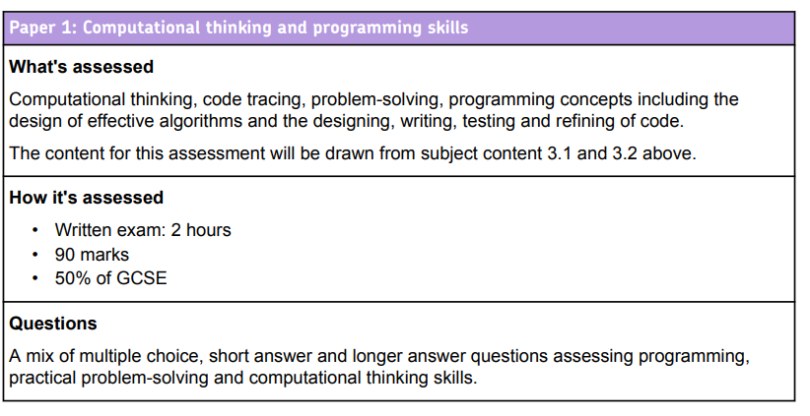
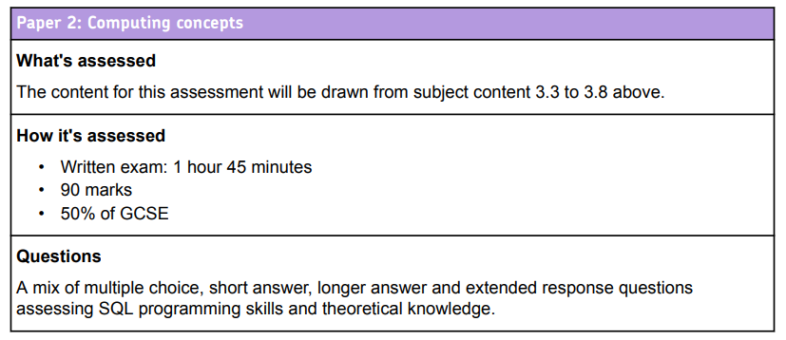
BTHCC KS4 Computer Science Curriculum
In Computing we develop innovative future leaders in the digital world who can use computational thinking to solve real world problems. We are dedicated to providing our students with the knowledge and tools to use technology responsibly, safely and ethically. We strive to ensure that the skills and foundations of IT systems help students in their future careers.
Computational Thinking | Computer Systems
Programming | Network and communication
Data representation | Cyber security
Digital Literacy | Information Technology
 |  | HT 1 | HT 2 |  | HT 3 |  |  | HT 4 |  | HT 5 |  | HT 6
Year 10 | Paper 2 2 periods per week | 3.3 Data Representation |  |  | 3.4 Computer Systems |  |  |  |  |  |  | 3.5 Computer Networks
 | Paper 1 1 period per week | 3.1 Fundamentals of Algorithms | 3.2 Programming- Python
Year 11 | Paper 2 2 periods per week | 3.6 Cyber Security | 3.7 Databases and SQL | 3.8 Impacts |  | 3.3 Data Representation | 3.4 Computer Systems |  | 3.5 Networks |  | Paper 1 Revision | Paper 1 and Paper Exams
 | Paper 1 1 period per week | 3.1 Fundamentals of Algorithms
 |  | 3.2 Programming-Python
Digital Literacy and Information Technology will be developed through activities in all units

Slide 5
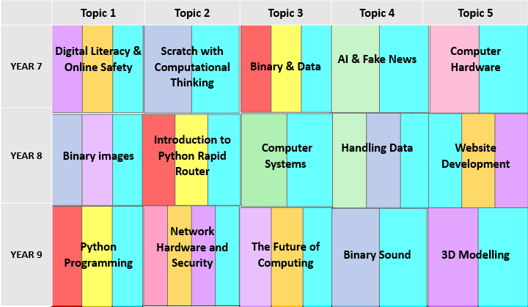
Computer Science End Point
Computational Thinking | Computer Systems
Programming | Network and communication
Data representation | Cyber security
Digital Literacy | Information Technology
 |  | HT 1 | HT 2 |  | HT 3 |  |  | HT 4 |  | HT 5 |  | HT 6
Year 10 | Paper 2 2 hours per week | 3.3 Data Representation |  |  | 3.4 Computer Systems |  |  |  |  |  |  | 3.5 Computer Networks
 | Paper 1 1 hour per week | 3.1 Fundamentals of Algorithms | 3.2 Programming- Python
Year 11 | Paper 2 2 hours per week | 3.6 Cyber Security | 3.7 Databases and SQL | 3.8 Impacts |  | 3.3 Data Representation | 3.4 Computer Systems |  | 3.5 Networks |  | Paper 1 Revision | Paper 1 and Paper Exams
 | Paper 1 1 hour per week | 3.1 Fundamentals of Algorithms
 |  | 3.2 Programming-Python
Digital Literacy and Information Technology will be developed through activities in all units
 | HT 1 |  |  | HT2 |  |  | HT3 |  | HT4 | HT5 | HT6
Year 12 Teacher 1 | Fundamentals of data representation |  |  | Fundamentals of communication and networking |  |  | Fundamentals of data structures |  | Fundamentals of algorithms | EA Programming Project Analysis Design Implementation
Year 12 Teacher 2 | Fundamentals of computer systems | Fundamentals of computer organisation and architecture | Consequences of uses of computing |  | Big Data | Fundamentals of databases | Fundamentals of programming
Year 13- Recall and Revision for Paper 2 Data, Networks, Computer Systems, Organisation and Architecture, Consequences, Big Data and Databases
Year 13 | NEA- Programming Project Implementation Testing Evaluation |  |  | Fundamentals of programming Fundamentals of data structures Fundamentals of algorithms Theory of computation |  |  | Prep for Skeleton Code | Recall and Revision for Paper 2 |  |  | Paper 1 and 2 A Level Exams
 |  |  |  |  |  |  |  | Recall and Revision for Paper 1
 |  |  |  |  |  |  |  | Skeleton Code Theory and Practical Tasks

Slide 6
BTHCC KS5 Computer Science Curriculum
In Computing we develop innovative future leaders in the digital world who can use computational thinking to solve real world problems. We are dedicated to providing our students with the knowledge and tools to use technology responsibly, safely and ethically. We strive to ensure that the skills and foundations of IT systems help students in their future careers.
Computational Thinking | Computer Systems
Programming | Network and communication
Data representation | Cyber security
Digital Literacy | Information Technology
A LEVEL COMPUTER SCIENCE
PAPER 2- Computational Thinking and Programming (40%) | PAPER 2: Computing Concepts(40%) | NON-EXAM ASSESSMENT – Programming Project(20%)
 | HT 1 |  |  | HT2 |  |  | HT3 |  | HT4 | HT5 | HT6
Year 12 Teacher 1 | Fundamentals of data representation |  |  | Fundamentals of communication and networking |  |  | Fundamentals of data structures |  | Fundamentals of algorithms | NEA Programming Project Analysis Design Implementation
Year 12 Teacher 2 | Fundamentals of computer systems | Fundamentals of computer organisation and architecture | Consequences of uses of computing |  | Big Data | Fundamentals of databases | Fundamentals of programming
Year 13- Recall and Revision for Paper 2 Data, Networks, Computer Systems, Organisation and Architecture, Consequences, Big Data and Databases
Year 13 | NEA- Programming Project Implementation Testing Evaluation |  |  | Fundamentals of programming Fundamentals of data structures Fundamentals of algorithms Theory of computation |  |  | Prep for Skeleton Code | Recall and Revision for Paper 2 |  |  | Paper 1 and 2 A Level Exams
 |  |  |  |  |  |  |  | Recall and Revision for Paper 1
 |  |  |  |  |  |  |  | Skeleton Code Theory and Practical Tasks

Slide 7

KS3 Assessment Computer Science at BTHCC
Securing
Formative Assessments
Progress Checks half way through a unit to assess understanding and misconceptions.
Practical Assessments
At the end of a practical unit pupils be assessed using an assessment Rubric. The teacher will assess the practical work by selecting the criteria from the assessment grid with the skills ranked as Emerging, Developing, Securing or Mastering.
Summative Assessments
The pupils will complete summative assessments at scheduled times in the year
They will be assessed on all of their knowledge in the subject at that point.
These assessments will be a google form that will be a mixture of multiple choice and written answers marked by the teacher and they will be awarded Emerging, Developing, Securing or Mastering.
Mastering
Emerging
Developing
Emerging – beginning to learn/understand subject area
Developing –showing an increased understanding in the subject area
Securing –achieved a sound understanding and ability in the subject area
Mastering – You show deeper understanding and higher level skill in the subject area and can make connections between different subject areas

