Slide 1
BTHCC KS3 Computer Science Curriculum
In Computing we develop innovative future leaders in the digital world who can use computational thinking to solve real world problems. We are dedicated to providing our students with the knowledge and tools to use technology responsibly, safely and ethically. We strive to ensure that the skills and foundations of IT systems help students in their future careers.
.
Computational Thinking | Computer Systems
Programming | Network and communication
Data representation | Cyber security
Digital Literacy | Information Technology
 | Topic 1 | Topic 2 | Topic 3 | Topic 4 | Topic 5
YEAR 7 | Online Safety | Binary Numbers | Scratch | Components of computers | Networks
YEAR 8 | Binary images | Introduction to Python Rapid Router | Computer Systems | Handling Data | Website Development
YEAR 9 | Python Programming | Network Hardware and Security | The Future of Computing | Binary Sound
Notes:
Year 7
Online Safety – Change following 1. log on, tour of the system school system, word process some rules and save 2. Gmail and sending emails + google classroom 3. Social Media(grooming) and gaming risks 4. Sexting and Cyber bullying 5+6 Collaborative presentation CAL
Binary Numbers – To stay the same, jazz it up CAL
Scratch – Algorithms – More emphasis on the 3 programming constructs (Sequence, Selection, Iteration) and problem solving. SGT
Components of a computer – Needs refreshing is out of date. Look over so students understand the basic components of a computer. Storage can be linked to the binary. MBN
Networks – Updating make it more interactive.
Year 8
Binary Images – Spend more time on skills and building up skill set SBA
Python unit moved forward – Review SOW possibly change to - Turing Lab – Edu Blocks – Linear search homework
Computer Systems – Moved Forward Focus – RAM, ROM, CPU, etc
Website development – Can stay the same
Handling Data Unit - to be moved forward - MBN
Year 9
Lesson1 – Recall on what an algorithm is look at bubble sort and possibly linear search recall. Python arrays to be added. Sort algorithm (bubble)

Slide 2


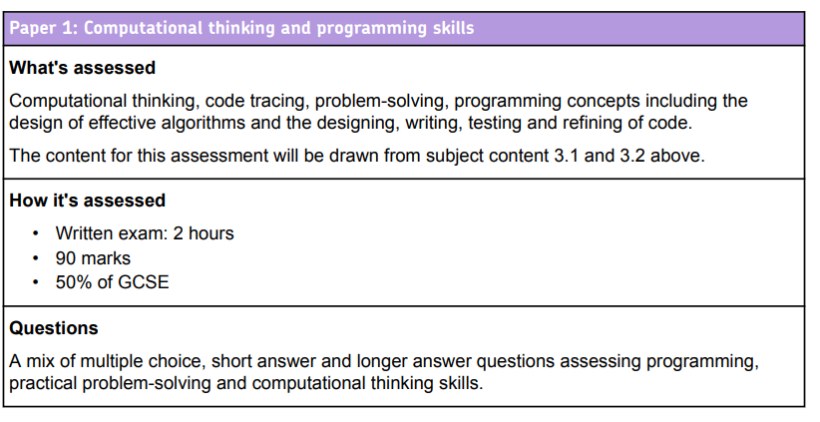
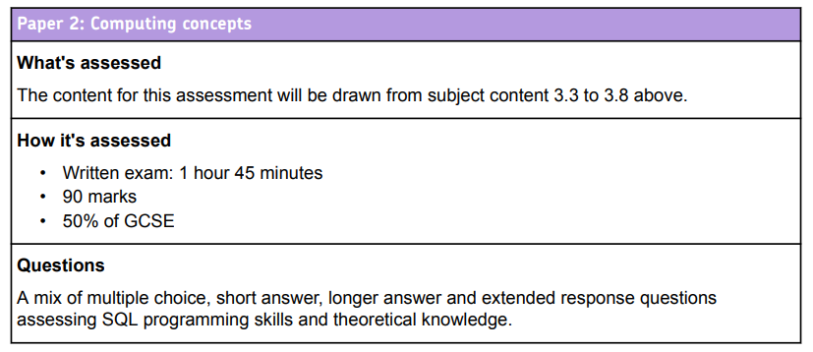
BTHCC KS4 Computer Science Curriculum
In Computing we develop innovative future leaders in the digital world who can use computational thinking to solve real world problems. We are dedicated to providing our students with the knowledge and tools to use technology responsibly, safely and ethically. We strive to ensure that the skills and foundations of IT systems help students in their future careers.
Computational Thinking | Computer Systems
Programming | Network and communication
Data representation | Cyber security
Digital Literacy | Information Technology
 |  | HT 1 | HT 2 |  | HT 3 |  |  | HT 4 |  | HT 5 |  | HT 6
Year 10 | Paper 2 2 periods per week | 3.3 Data Representation |  |  | 3.4 Computer Systems |  |  |  |  |  |  | 3.5 Computer Networks
 | Paper 1 1 period per week | 3.1 Fundamentals of Algorithms | 3.2 Programming- Python
Year 11 | Paper 2 2 periods per week | 3.6 Cyber Security | 3.7 Databases and SQL | 3.8 Impacts |  | 3.3 Data Representation | 3.4 Computer Systems |  | 3.5 Networks |  | Paper 1 Revision | Paper 1 and Paper Exams
 | Paper 1 1 period per week | 3.1 Fundamentals of Algorithms
 |  | 3.2 Programming-Python
Digital Literacy and Information Technology will be developed through activities in all units

Slide 3
BTHCC KS5 Computer Science Curriculum
In Computing we develop innovative future leaders in the digital world who can use computational thinking to solve real world problems. We are dedicated to providing our students with the knowledge and tools to use technology responsibly, safely and ethically. We strive to ensure that the skills and foundations of IT systems help students in their future careers.
Computational Thinking | Computer Systems
Programming | Network and communication
Data representation | Cyber security
Digital Literacy | Information Technology
A LEVEL COMPUTER SCIENCE
PAPER 2- Computational Thinking and Programming (40%) | PAPER 2: Computing Concepts(40%) | NON-EXAM ASSESSMENT – Programming Project(20%)
 | HT 1 |  |  | HT2 |  |  | HT3 |  | HT4 | HT5 | HT6
Year 12 Teacher 1 | Fundamentals of data representation |  |  | Fundamentals of communication and networking |  |  | Fundamentals of data structures |  | Fundamentals of algorithms | NEA Programming Project Analysis Design Implementation
Year 12 Teacher 2 | Fundamentals of computer systems | Fundamentals of computer organisation and architecture | Consequences of uses of computing |  | Big Data | Fundamentals of databases | Fundamentals of programming
Year 13- Recall and Revision for Paper 2 Data, Networks, Computer Systems, Organisation and Architecture, Consequences, Big Data and Databases
Year 13 | NEA- Programming Project Implementation Testing Evaluation |  |  | Fundamentals of programming Fundamentals of data structures Fundamentals of algorithms Theory of computation |  |  | Prep for Skeleton Code | Recall and Revision for Paper 2 |  |  | Paper 1 and 2 A Level Exams
 |  |  |  |  |  |  |  | Recall and Revision for Paper 1
 |  |  |  |  |  |  |  | Skeleton Code Theory and Practical Tasks

Slide 4
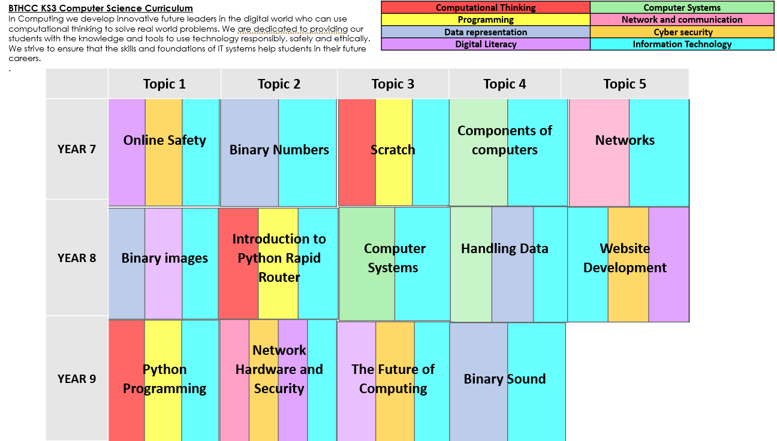
Computer Science End Point
Computational Thinking | Computer Systems
Programming | Network and communication
Data representation | Cyber security
Digital Literacy | Information Technology
 |  | HT 1 | HT 2 |  | HT 3 |  |  | HT 4 |  | HT 5 |  | HT 6
Year 10 | Paper 2 2 hours per week | 3.3 Data Representation |  |  | 3.4 Computer Systems |  |  |  |  |  |  | 3.5 Computer Networks
 | Paper 1 1 hour per week | 3.1 Fundamentals of Algorithms | 3.2 Programming- Python
Year 11 | Paper 2 2 hours per week | 3.6 Cyber Security | 3.7 Databases and SQL | 3.8 Impacts |  | 3.3 Data Representation | 3.4 Computer Systems |  | 3.5 Networks |  | Paper 1 Revision | Paper 1 and Paper Exams
 | Paper 1 1 hour per week | 3.1 Fundamentals of Algorithms
 |  | 3.2 Programming-Python
Digital Literacy and Information Technology will be developed through activities in all units
 | HT 1 |  |  | HT2 |  |  | HT3 |  | HT4 | HT5 | HT6
Year 12 Teacher 1 | Fundamentals of data representation |  |  | Fundamentals of communication and networking |  |  | Fundamentals of data structures |  | Fundamentals of algorithms | NEA Programming Project Analysis Design Implementation
Year 12 Teacher 2 | Fundamentals of computer systems | Fundamentals of computer organisation and architecture | Consequences of uses of computing |  | Big Data | Fundamentals of databases | Fundamentals of programming
Year 13- Recall and Revision for Paper 2 Data, Networks, Computer Systems, Organisation and Architecture, Consequences, Big Data and Databases
Year 13 | NEA- Programming Project Implementation Testing Evaluation |  |  | Fundamentals of programming Fundamentals of data structures Fundamentals of algorithms Theory of computation |  |  | Prep for Skeleton Code | Recall and Revision for Paper 2 |  |  | Paper 1 and 2 A Level Exams
 |  |  |  |  |  |  |  | Recall and Revision for Paper 1
 |  |  |  |  |  |  |  | Skeleton Code Theory and Practical Tasks

