Slide 1

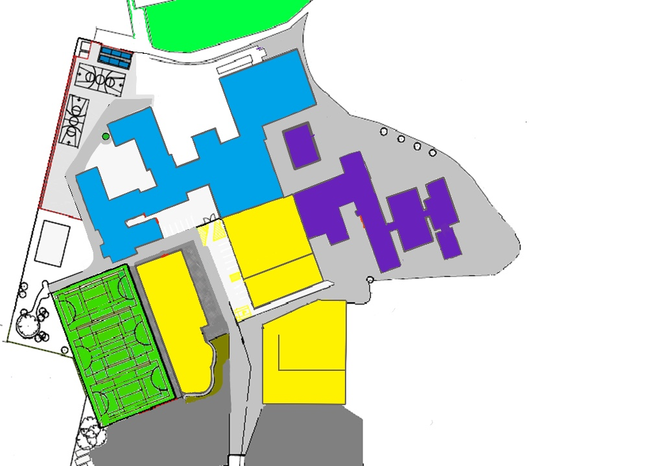

Fire Assembly Points
Year 11
On Hearing the Fire Alarm (siren sound):
Evacuate the building in a calm and safe manner
Proceed to your designated assembly point
Year 10
Tech
Playground
Year 9
Art
Hall
Science
RE/Music
Science
Gym
English
Year 12/13
Sixth Form
Support Staff / Visitors
Year 7
Year 8
Sports Hall

Slide 2
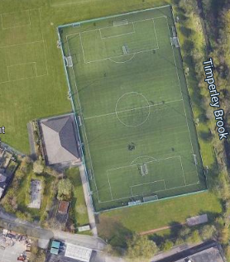
3G Fire Lettings Assembly Point
Sports Academy
On Hearing the Fire Alarm (siren sound):
Evacuate the building/pitch in a calm and safe manner
Proceed to the designated assembly point
Science
RE/Music
Science
Fire Assembly Point

Slide 3
MUGA Lettings Fire Assembly Point
On Hearing the Fire Alarm (siren sound):
Evacuate the building/pitch in a calm and safe manner
Proceed to the designated assembly point
Sixth Form
Science
RE/Music
Science
Fire Assembly Point

Slide 4
Sports Hall Lettings Fire Assembly Point
On Hearing the Fire Alarm (siren sound):
Evacuate the building/pitch in a calm and safe manner
Proceed to the designated assembly point
Sixth Form
Science
Sports
Hall
RE/Music
Science
Fire Assembly Point
Fire Assembly Point

